Slide 1

The User Interface

Slide 2

We are Learning to:
describe the main features of different types of user interface: WIMP, command line and forms dialogue;
evaluate different types of user interface: WIMP, command line and forms dialogue;

Slide 3
Introduction
In order for an application to be successful, developers always try to make their product easy to use and attractive to the user. They spend a lot of time working on how the interface looks and feels to the user and they will take into consideration things such as how the end user interacts with the software. The end user wants an application that will complete a task quickly and easily.
There are a variety of approaches taken to the development of a user interface and the interface type chosen will often depend on a variety of factors such as:-
User ability
Range of input and output devices available
Processor capability
Memory capacity

Slide 4
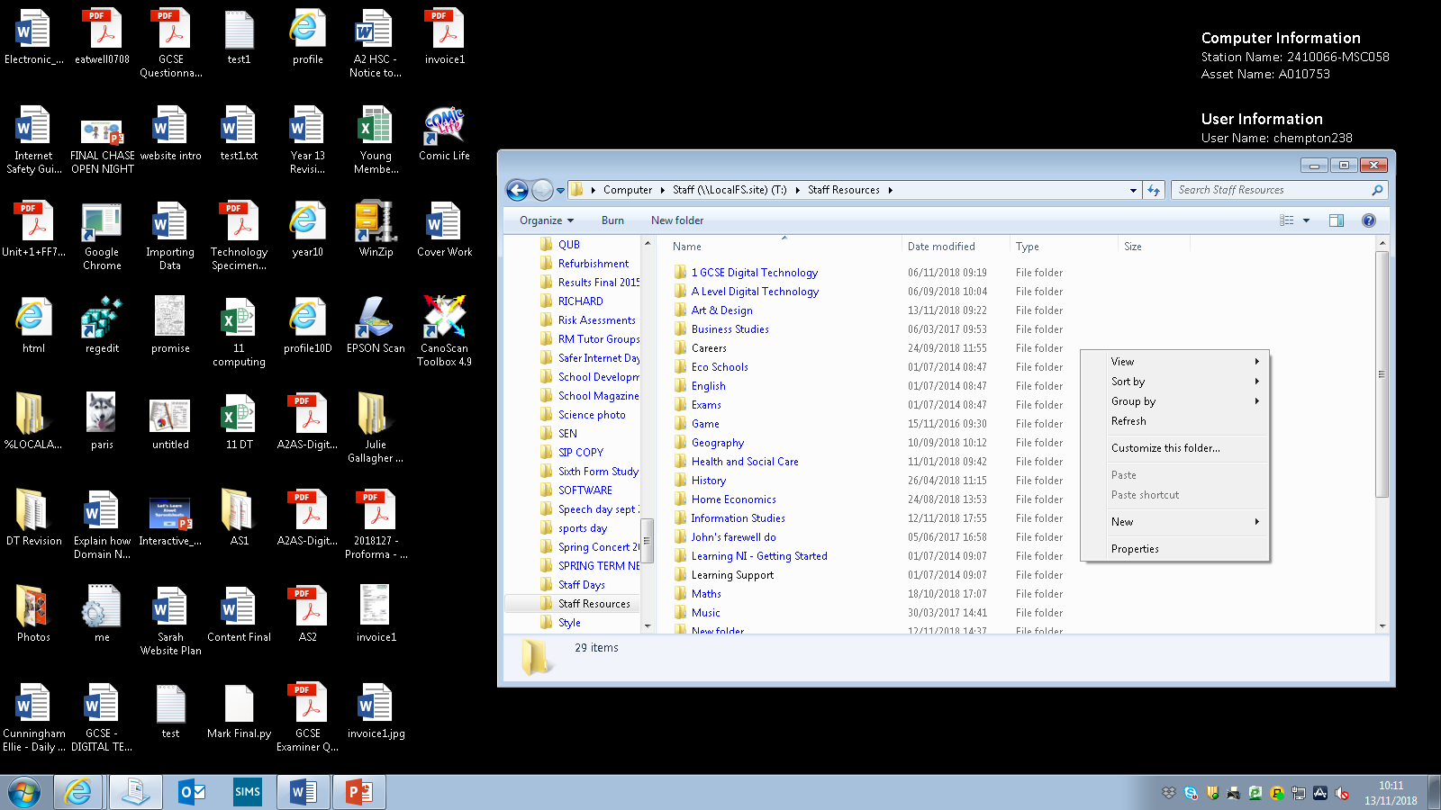
WIMP Interface
The WIMP interface will allow the user to communicate with the computer using:-
WINDOWS
POINTER (Cursor)
MENUS
ICONS

Slide 5
WIMP Interface
Windows – These represent an active area of the computer screen which is opened up to display some form of activity; perhaps in the form of processing in a program or perhaps presenting a range of files and folders. More than one window can be open on screen at any one time and it can be moved around or closed down.
Icons – These are small pictures used to provide a graphical representation of an application or activity. An icon can be selected by moving a selection tool over the top of the icon and an activity can be started through double clicking on the icon.
Menus – A menu is used to present an end user with a range of options. The menu system is used to group related options / actions together. A variety of menu types may be presented to the end user including pop-up menus (often used to present a series of shortcuts to the user when they right click on the computer screen) and pull-down menus (normally used to present a range of options / items in a submenu, linked to a menu title presented across the top of a screen).

Slide 6
Who uses a wimp interface
Pointers – A pointer will move around a computer screen based on the movements instigated by the end users manipulation of a peripheral device such as a tracker pad or a mouse. The pointer can be used to select an item on screen, (for example an icon or a menu option) it may change shape. The user can then initiate further action to indicate their desire to select said item; perhaps a left button click or double click.
WYSIWYG
WHO USES A WIMP INTERFACE?
An Inexperienced User

Slide 7
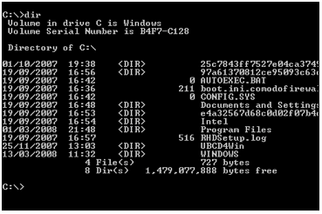
Command Line Interface
Features of a Command Line Interface
User input consists of single characters/words
Commands are entered at a prompt
With possible parameters
Help can be obtained using an appropriate command

Slide 8
Command Line Interface
A command line interface, such as the one shown in the previous slide, allows the user to type commands which the computer will execute.
Commands are usually fixed in structure (syntax) and limited to one line. Users require an intricate knowledge of the internal operation of the computer in order to use a command line interface sufficiently and they must be well versed in the range of acceptable commands made available to them using the interface.
Instructions can be combined to carry out more complex tasks.
WHO USES A COMMAND LINE INTERFACE?
An Experienced User

Slide 9
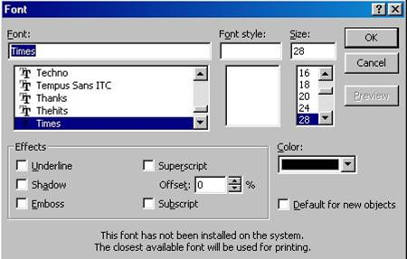
FORMS DIALOGUE
Examples of a forms dialogue interface are shown below
The screen is designed as a data entry form
The user enters the data into an appropriate part of the form
Data may be entered as text in text boxes
Or from selecting from a drop down menu
Or by ticking checkboxes/radio Buttons
The user is taken through in a predetermined order
Validation may be performed
Software
Windows

Slide 10
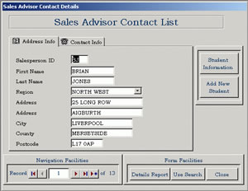
FORMS DIALOGUE
As can be seen above, a form dialogue interface will output prompts and response fields to the user on screen. The user must then provide input via each of the empty fields, which must be completed.
A forms dialogue interface will use the following methods to secure the required input from the end user:-
Response field – a position on the forms dialogue box where the end user will enter a response. They may move the cursor from field to field, e.g. with a mouse click or perhaps using the tab key on a keyboard.
Prompt – a prompt may appear for the end user at the position where data entry is required. The prompt may be in the form of a flashing cursor in a response field.
Error messages – used to inform the end user there has been an error in the data entry process. The most user friendly error messages will include some form of diagnostic information for the end user.
Forms in a
Database

Slide 11
Evaluating User Interfaces
Interface Type | Applications | Advantages | Disadvantages
WIMP | Suitable for less experienced user. | Intuitive for the user. Provides user with simple approach to carrying out complicated tasks. You do not have to learn complicated commands Usually good help facilities with a WIMP Interface They let you exchange data between software programmes | Complex interfaces of this nature require extensive resources for effective operation. GUIs take up a much larger amount of hard disk space / RAM / Processing Power than other interfaces Slow for experienced users to use compared to CLI

Slide 12
Interface Type | Applications | Advantages | Disadvantages
Command Line | Suitable for experienced users who need to maximise processing capabilities of the computer. | Minimum resources required to display interface to end user. If the user knows the commands it can be much faster to use. A CLI does not require Windows to run | User must be familiar with syntax. Complex command sequences are required for more complicated tasks. Commands need to be inserted precisely – If a spelling error is made the command will fail. If you mis-type an instruction, it is often necessary to start again. Hundreds of commands need to be learned.

Slide 13
Interface Type | Applications | Advantages | Disadvantages
Forms Dialogue (Menu Driven) | Suitable for use when entering data into a database or when completing a task using a wizard application. | Supports the user through the data entry process. Ensures the end user is presented with an opportunity to enter all data required to complete the current task. Data Validation can be used on data entry forms Little or no training required Doesn’t require large amounts of processing power or memory | Limits the data entry options available to the end user. Visually Impaired might have bother seeing the text or options Not good for highly complex applications. A tax form might have 20 pages that needs completed.

Slide 14
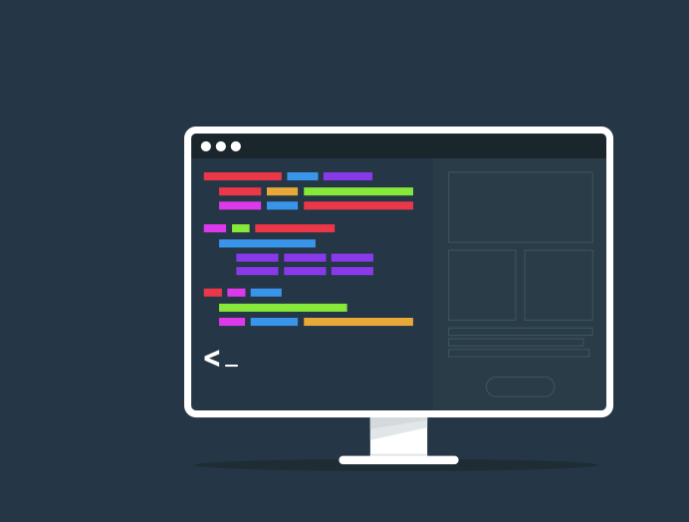
The Importance of an Interface
What is an interface?
What makes a good interface?
Why would we need different interfaces?

Slide 15
> What is a WIMP?
> WYSIWYG
> Windows
> Icons
> Menus
> Pointers

Slide 16
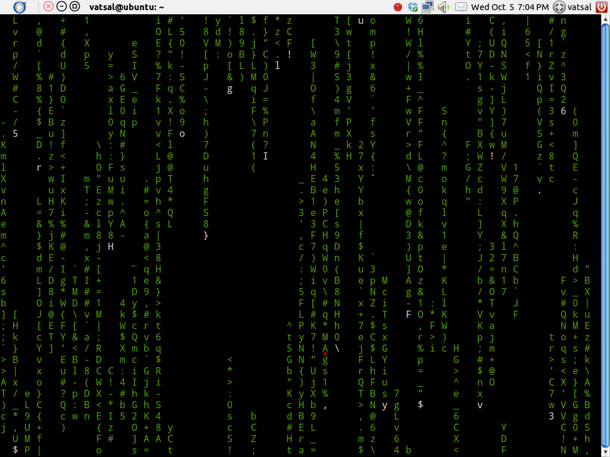
Command Line
Limited visual aesthetics
Allows commands to be manually typed
User must be well versed as limited range of commands
Combining instructions can lead to more complex tasks.
No use for a mouse, all keyboard interaction
No room for typos/spelling mistakes as this will not run
Over 270 commands available, including run, open, delete etc
Considered more difficult over other interfaces

Slide 17
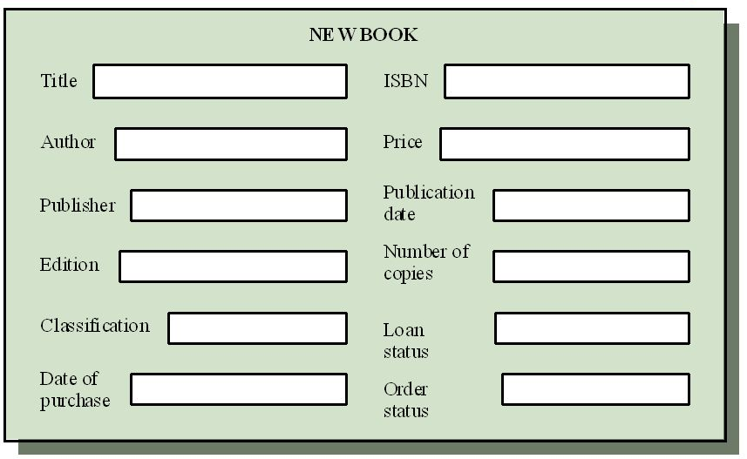
Forms Interface
Very ‘functional’ and efficient
Can incorporate textboxes, dropdowns, radio buttons, etc
Very linear as user is taken through step by step
Validation is easy to implicate

Slide 18

Activity: Pick Me! Pick Me!
In your teams, design an interface for the following tasks:
  Allow a customer to book a ticket at a cinema
  Allow a programmer to find files/reports and perform CRUD elements to these files
  Allow a student to create flash cards for synopsis for films (with dates/times/etc)
  Allow a staff member to search for a customer’s details
You will then be asked to relay your designs to the rest of the class and justify your use of using your named interface.
You need to annotate your designs in full – link these to your UI notes!

Slide 19
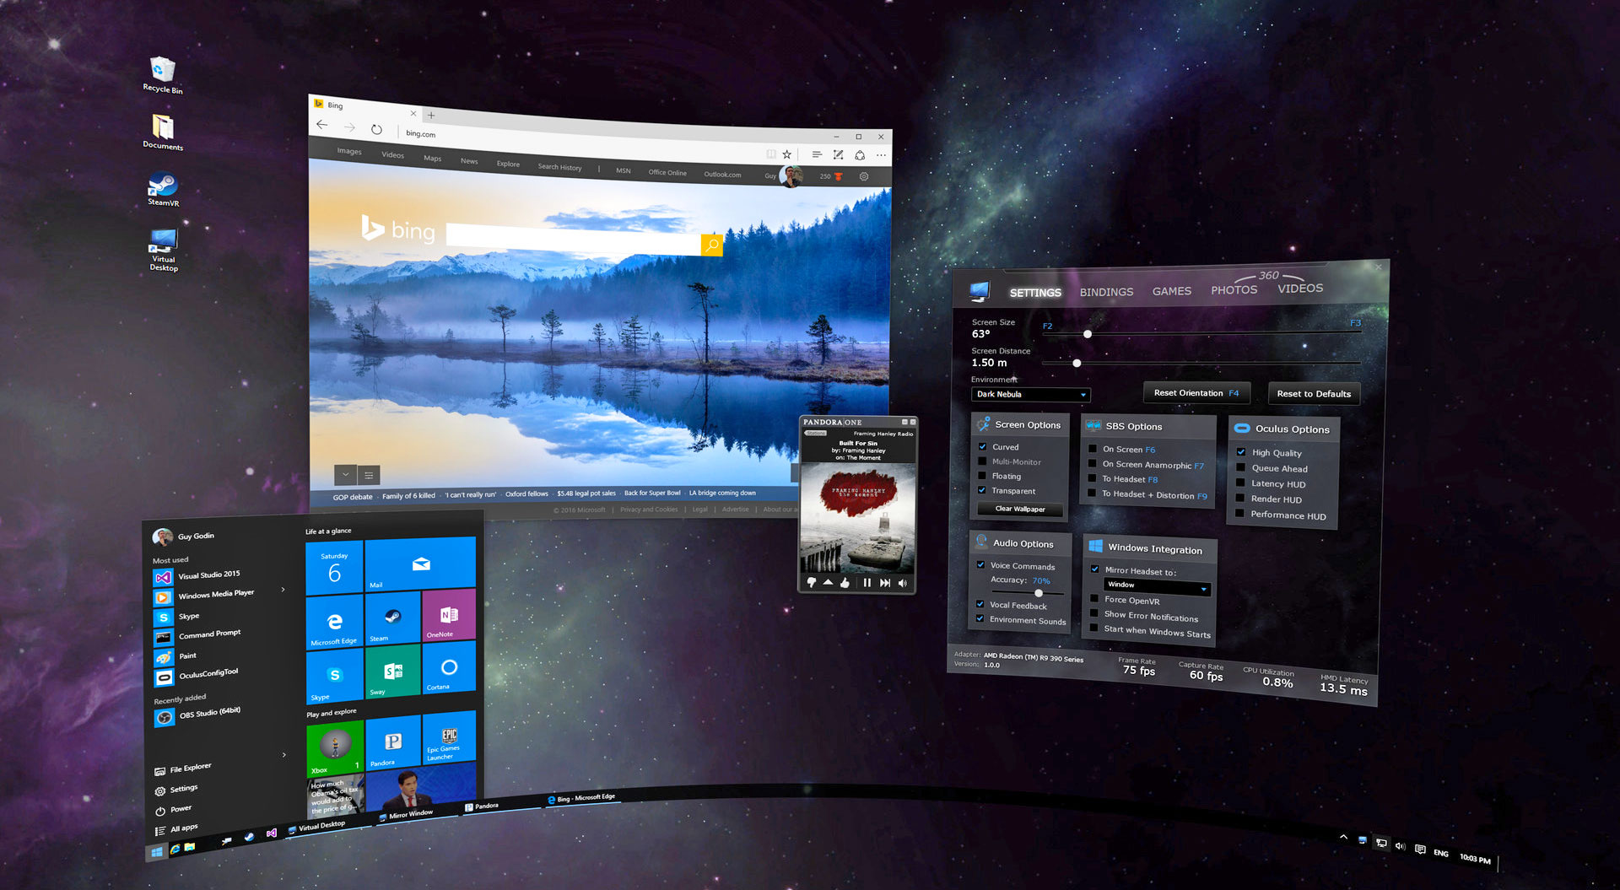
Applications for WIMP interfaces
Suited for less experienced users – why?
  Intuitive for the user
  Simple approach to carrying out tasks
  No complicated commands
  Extensive help options
  Exchange data between software programmes
Why would we not use a WIMP interface?
  Requires much more hardware/processing power (HDD space, RAM, etc)
  Slow for experienced users (compared to CL interfaces)

Slide 20
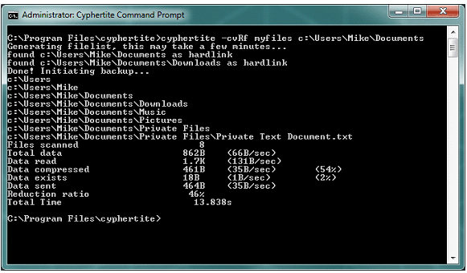
Applications for Command Line Interfaces
> Suitable for very experienced users – why?
  > Maximises processing power
  > Minimum resources required
  > Doesn’t require windows
> Limitations?
  > User must know syntax
  > Must be precise / cannot mistype instructions
  > Hundreds of commands need to be remembered/learnt

Slide 21
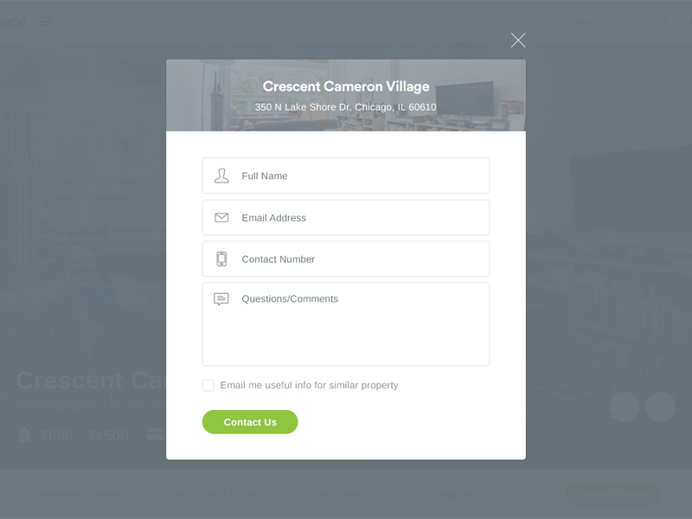
Applications of Forms Interfaces
When do we use forms on the computer?
  Entering data for a database
  Used for completing a task using a wizard
  Collects all information in one place
  Data validation
  Little-no training required
  Does not need a lot of processing power
Any limitations?
  Data entry is very limited
  May not suitable for visually impaired
  Not suitable for highly complex applications.

Slide 22
Past Paper Question
2017 Digital Technology
Command line and WIMP are two types of user interface.
Evaluate these interfaces from the point of view of an experienced computer user.
______________________________________________________________________________________________________________________________________________________________________________________________________________________________________________________________________________________________________________________________________________________________________________________________________________________________________________________________________________________________________________[4]

Slide 23
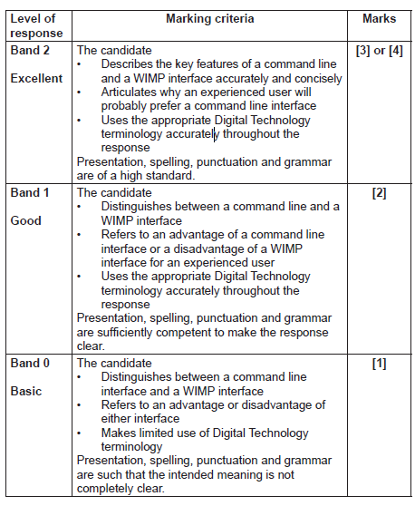
Mark Scheme
Command line interface
There is a pre-set list commands
Each command is entered at a prompt and usually includes parameters
and/or switches
WIMP
This is a GUI
Each task/process has its own window containing icons and/or menus
A pointer and mouse/touchpad are used to navigate and to select icons
and/or menu options
The experienced user
An experienced user may prefer a CLI as a single command may perform
a task which would require a long sequence of mouse clicks and menu
selections in a WIMP

Slide 24
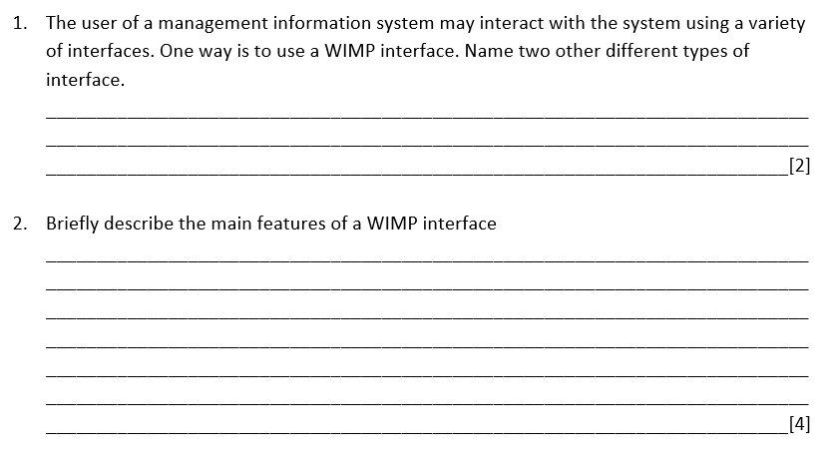

Slide 25
